Slide 1
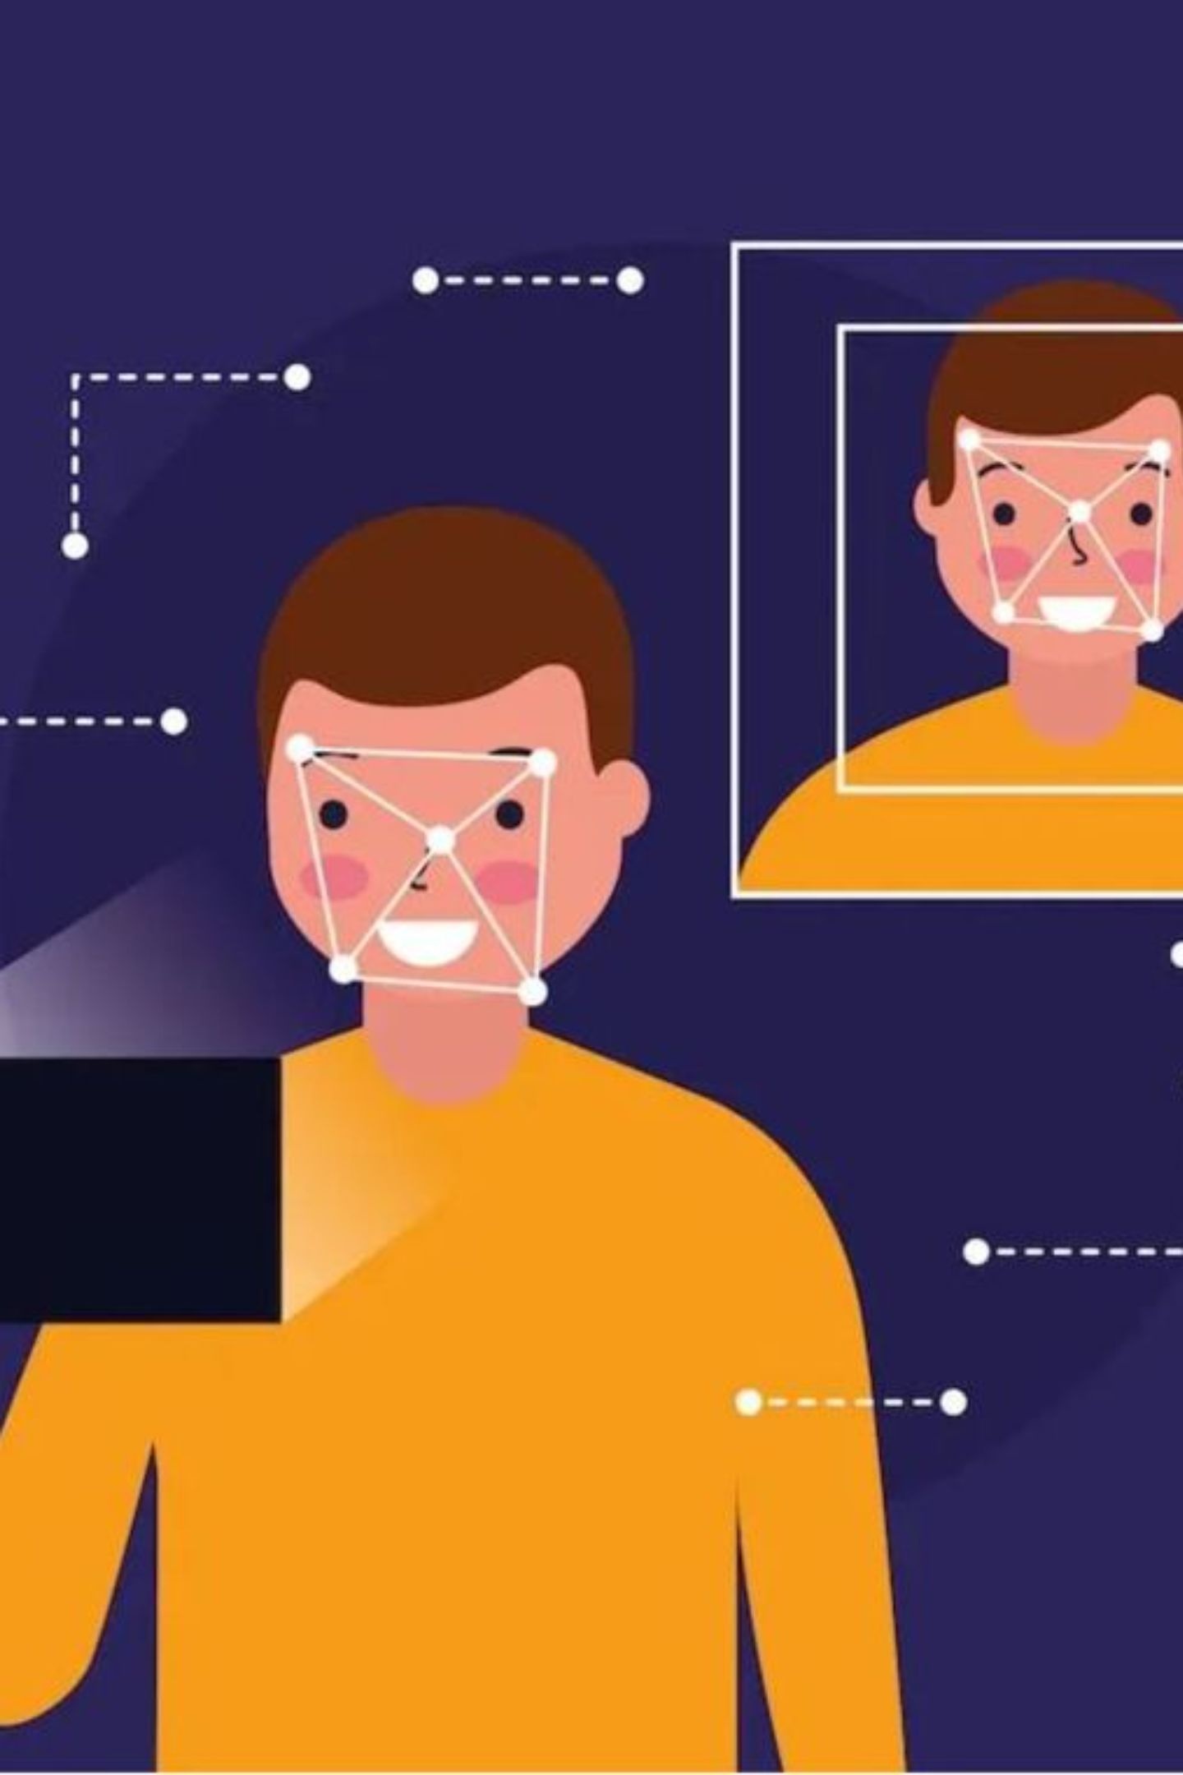
Smart Attendance with Mask and Face Recognition
Subject: Digital Image Processing
Team Students: -Murad khan
-Muaz Abdul Rab
-Mohd Hamza Khan
Faculty: Mr Shakir Ali
Date: 21/09/2026

Slide 2
Abstract
-Manual attendance is time-consuming and error-prone.
-We built a laptop/PC-based smart attendance system that uses Integrated or standard USB webcam to perform real-time face detection, mask detection, head-pose guidance, and face recognition.
-The system records attendance into SQLite and provides a Flask dashboard with live counters and Excel export.
Technologies: Python, OpenCV, MediaPipe, OpenCV SFace, Flask, SQLite, openpyxl.

Slide 3
Introduction
Problem:
Objective:
Scope:
Manual roll-calls waste class time and are prone to errors and proxy attendance.
Provide a simple, low-cost laptop-based system to automate attendance while handling masks and imperfect face poses.
Works with a standard laptop webcam or USB webcam; intended for classroom settings and demonstrations

Slide 4
Literature Review
Reference: "Lightweight face recognition-based portable attendance system with liveness detection" — Nico Surantha & Boy Sugijakko, Internet of Things, 2024.
Prototype Approach
Raspberry Pi 4B, USB camera, ultrasonic sensor; Viola-Jones for detection; MobileFaceNet for recognition; MobileNetV2 for liveness
Reported Prototype Results
Paper reported ~96% live-face accuracy and 0.48–0.57s processing time in prototype testing (reported by authors).
Relevance to Our Work
The paper motivates lightweight, portable attendance solutions and inclusion of liveness checks; we compare approaches but keep our own implementation details separate.

Slide 5

Previous System vs Our System
Aspect | Surantha & Sugijakko (2024) | Our Laptop-Based System
Platform | Raspberry Pi 4B prototype | Laptop with webcam
Face Detection | Viola-Jones | MediaPipe Face Landmarker (face detection & landmarks)
Face Recognition | MobileFaceNet | OpenCV SFace embeddings
Liveness / Anti-spoofing | MobileNetV2-based liveness | Motion / head-pose guidance signals (no CNN-based liveness)
Storage & Dashboard | Prototype-specific storage | SQLite storage + Flask dashboard + Excel export (openpyxl)
Note: Paper results are reported by the authors and are used only for literature comparison—not as results for our system

Slide 6

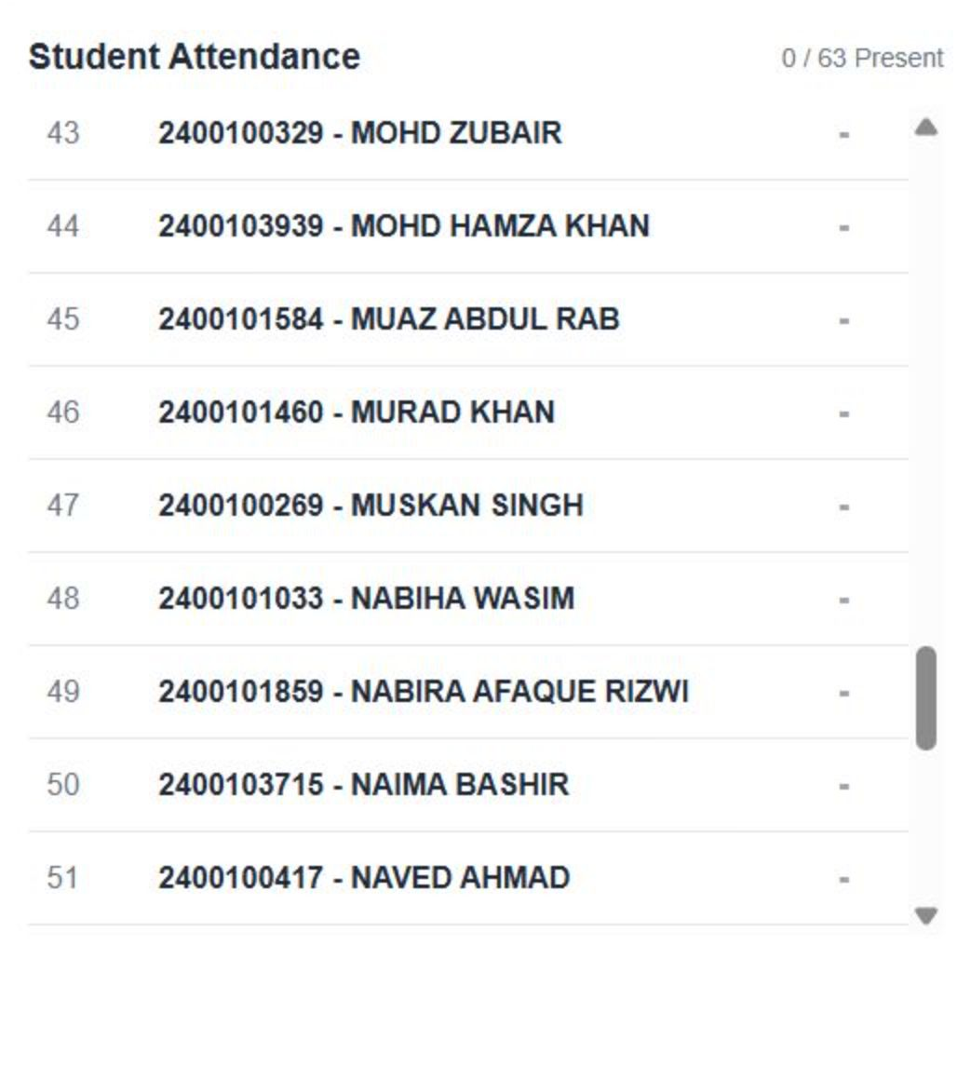
Dataset & Student Data
Classroom database contains records for 63 students (serial no., enrollment no., name).
Face data enrollment is guided: instructor-led enrollment for students present during demonstration.
Face templates are stored per enrolled student; do NOT assume all 63 students have face data enrolled.
Storage
face embeddings stored alongside student metadata in local files / SQLite references.

Slide 7






Methodology — System Pipeline
Capture & Detect
1
Webcam captures live video. MediaPipe detects faces and facial landmarks.
2
Pose & Embed
Head position is checked, and SFace generates a face embedding for recognition.
3
Verify Identity
The live face embedding is compared with enrolled student face data.
4
Confirm & Record
Multiple matching frames confirm the identity, and attendance is marked once.
5
Store & Display
Attendance is saved in SQLite and displayed on the Flask dashboard.
Runtime flow used during a 10-minute attendance session (automatic session end triggers database finalize and export options).

Slide 8
Technologies Used & Their Functions
Technology | Function
Python | Main programming language used to develop the system
Flask | Connect backend logic with the web dashboard
OpenCV | Process webcam frames and perform face recognition using SFace
MediaPipe | Detects Faces, facial landmarks and head-pose information
OpenCV SFace | Generates face embeddings and compare face identities
SQLite | Stores student details, attendance and session records
HTML/CSS/JavaScript | Creates the dashboard interface and live updates
openpyxl | Exports attendance records to Excel Files

Slide 9

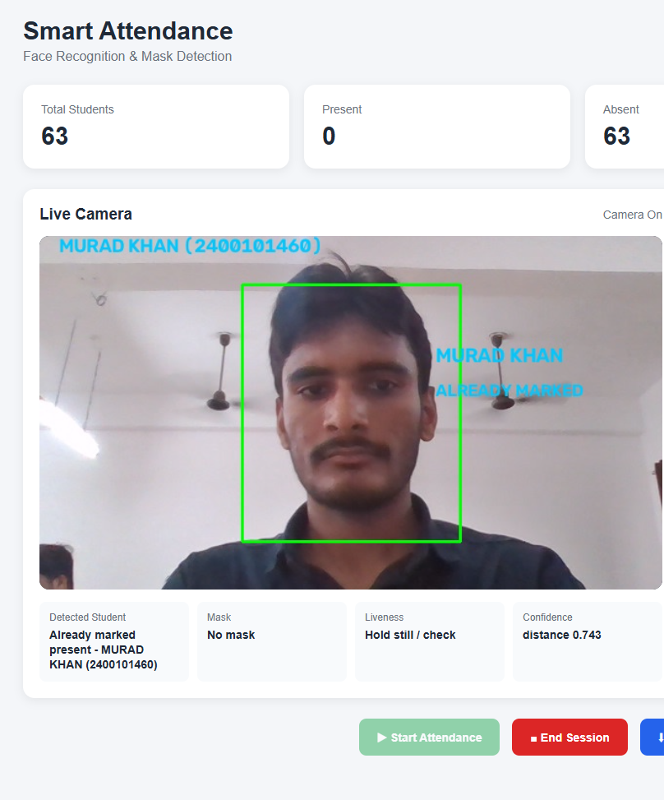
Experimental Results & Discussion
System demonstrates real-time face detection and recognition on laptop/USB webcams during live demos.
Mask detection flags masked faces and integrates with recognition flow.
Head-pose guidance improves chance of successful embedding by prompting users to adjust position.
Duplicate attendance prevention and multiple-frame confirmation reduce false positives
Flask dashboard updates live; attendance can be exported to Excel (openpyxl).

Slide 10
Challenges, Conclusion , Future Work & Current Limitation
1
2
3
4
Challenges
Conclusion
Future Work
Spoofing Risk
Variable lighting, occlusions from masks/glasses, limited enrolled face samples for some students, and reliance on head-pose/motion signals for liveness guidance.
We built a laptop-based, practical attendance system using MediaPipe and OpenCV SFace with a Flask dashboard and SQLite storage. The design prioritizes low-cost deployment and guided enrollment for classroom use.
Improve enrollment UX, add optional sensor-based or model-based anti-spoofing modules (evaluated separately), support larger-scale deployments, and collect controlled evaluation data for formal accuracy reporting.
Since our system uses a normal webcam and basic motion/head-pose guidance, it cannot completely prevent proxy attendance through photos or videos. Stronger liveness detection is required for improved security.
Thank you

